Slide 1

"Automated Certificate Authentication and Performance Evaluation System for Academic Institutions"
Evaluating performance based on claiming

Slide 2
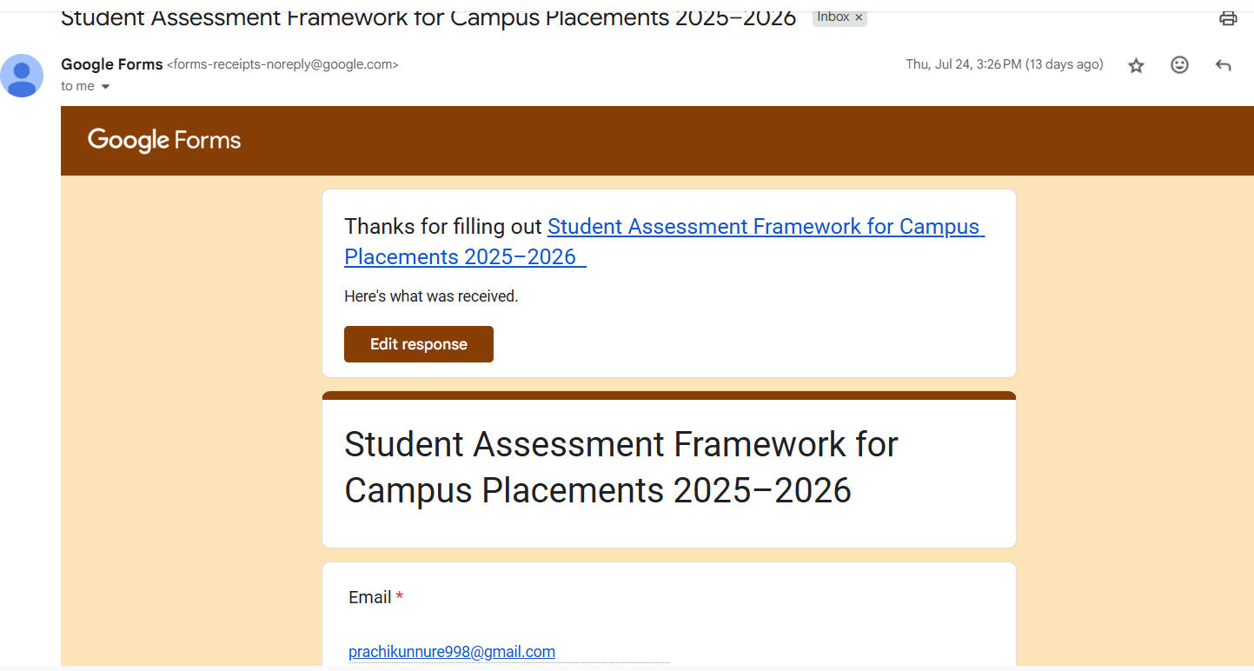
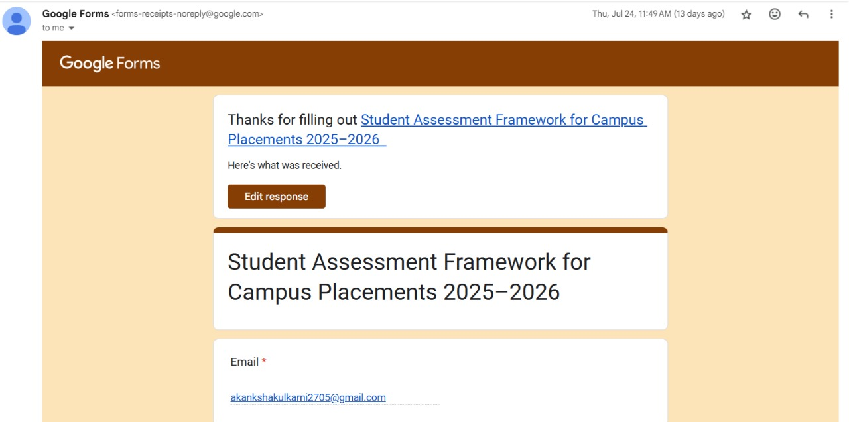
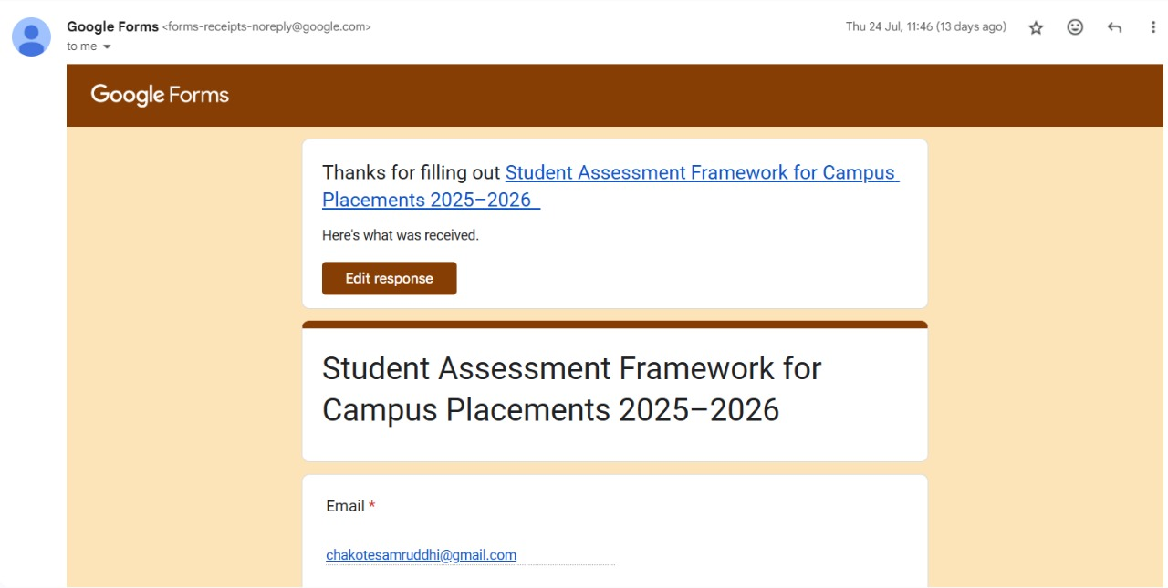
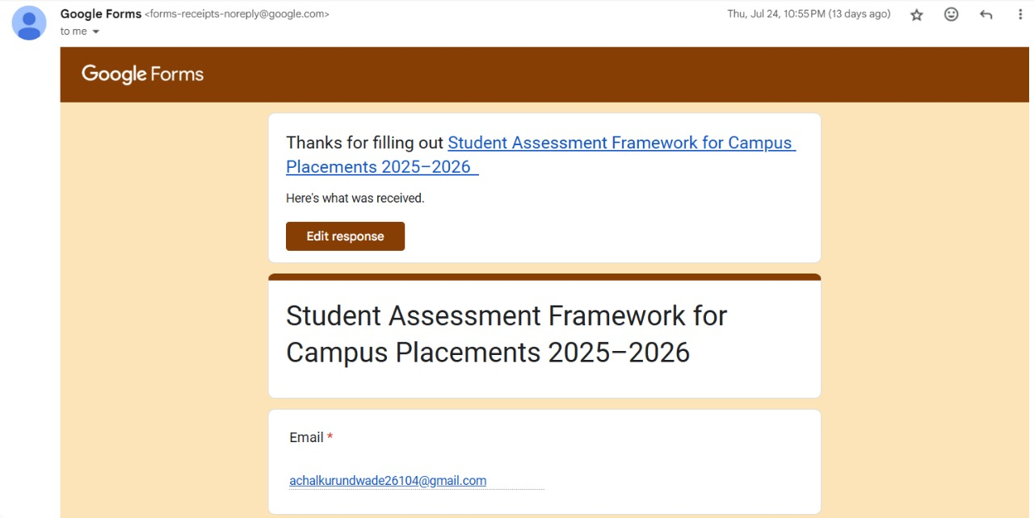

Slide 3
Problem Statement
In educational institutions, verifying student or faculty certificates manually is time-consuming, error-prone, and lacks standardization. Institutions need a reliable system to:
Verify certificate authenticity automatically
Assign marks or credits based on certificate type, issuer, and duration
Maintain a centralized and secure database for all submissions

Slide 4
Motivation /Need
Manual verification leads to inconsistency
Institutions lack a standardized scoring system for extra-curriculars, internships, or paper presentations
Automation can save time, improve accuracy, and encourage merit-based recognition

Slide 5
Objective
To build a web-based system that collects certificate data from students/faculty
To automatically authenticate the certificate using metadata/text analysis
To assign scores based on predefined rules (issuer, type, duration)
To provide a dashboard for faculty/admin to view evaluated submissions

Slide 6
Future Scope
LLM-based scoring (natural language analysis of certificates)
Certificate authenticity check with QR code/Blockchain
Integration with university portals
Support for auto email/WhatsApp updates to students
Extension to resume evaluation
.

Slide 7
Proposed Methodology
User submits certificate details (or uploads scanned PDF)
System extracts metadata (title, issuer, date, type)
Verifies:
Format validity
Organization authenticity
Expiry or duplication
Marks assigned based on rules
Data stored and result shown

Slide 8
Expected Outcome
A working system to verify and score certificates
Reduced admin workload for certificate validation
Transparent and standardized certificate-based scoring
Web interface for submission, review, and tracking

Slide 9
Technology Stack
Frontend: HTML, CSS, JavaScript, Bootstrap (React.js optional) Backend: Node.js + Express.js Database: MongoDB Authentication: JWT, bcrypt.js OCR Tools (optional): Tesseract.js, pdf-miner (Python) Analysis & Scoring: Custom logic or ML (optional)

Slide 10
Literature Review
Certificate Authentication Systems
University management systems lack intelligent verification
OCR + rule-based systems are gaining traction
Academic Scoring Models
Based on workshop type, duration, issuer reputation
Normalization of scores becoming common in placement assessments
Tech Studies
Certificate verification via QR, Blockchain, AI models
Source: IEEE, Springer (2022–2024)

Slide 11
Team Details and Role Distribution
Name | Role
Akanksha Kulkarni | Certificate Parsing & Scoring
Samruddhi Chakote | Frontend UI + Authentication
Prachi Kunnure | Backend APIs + Verification
Achal Kurundwade | Database & Admin Dashboard

